Slide 1
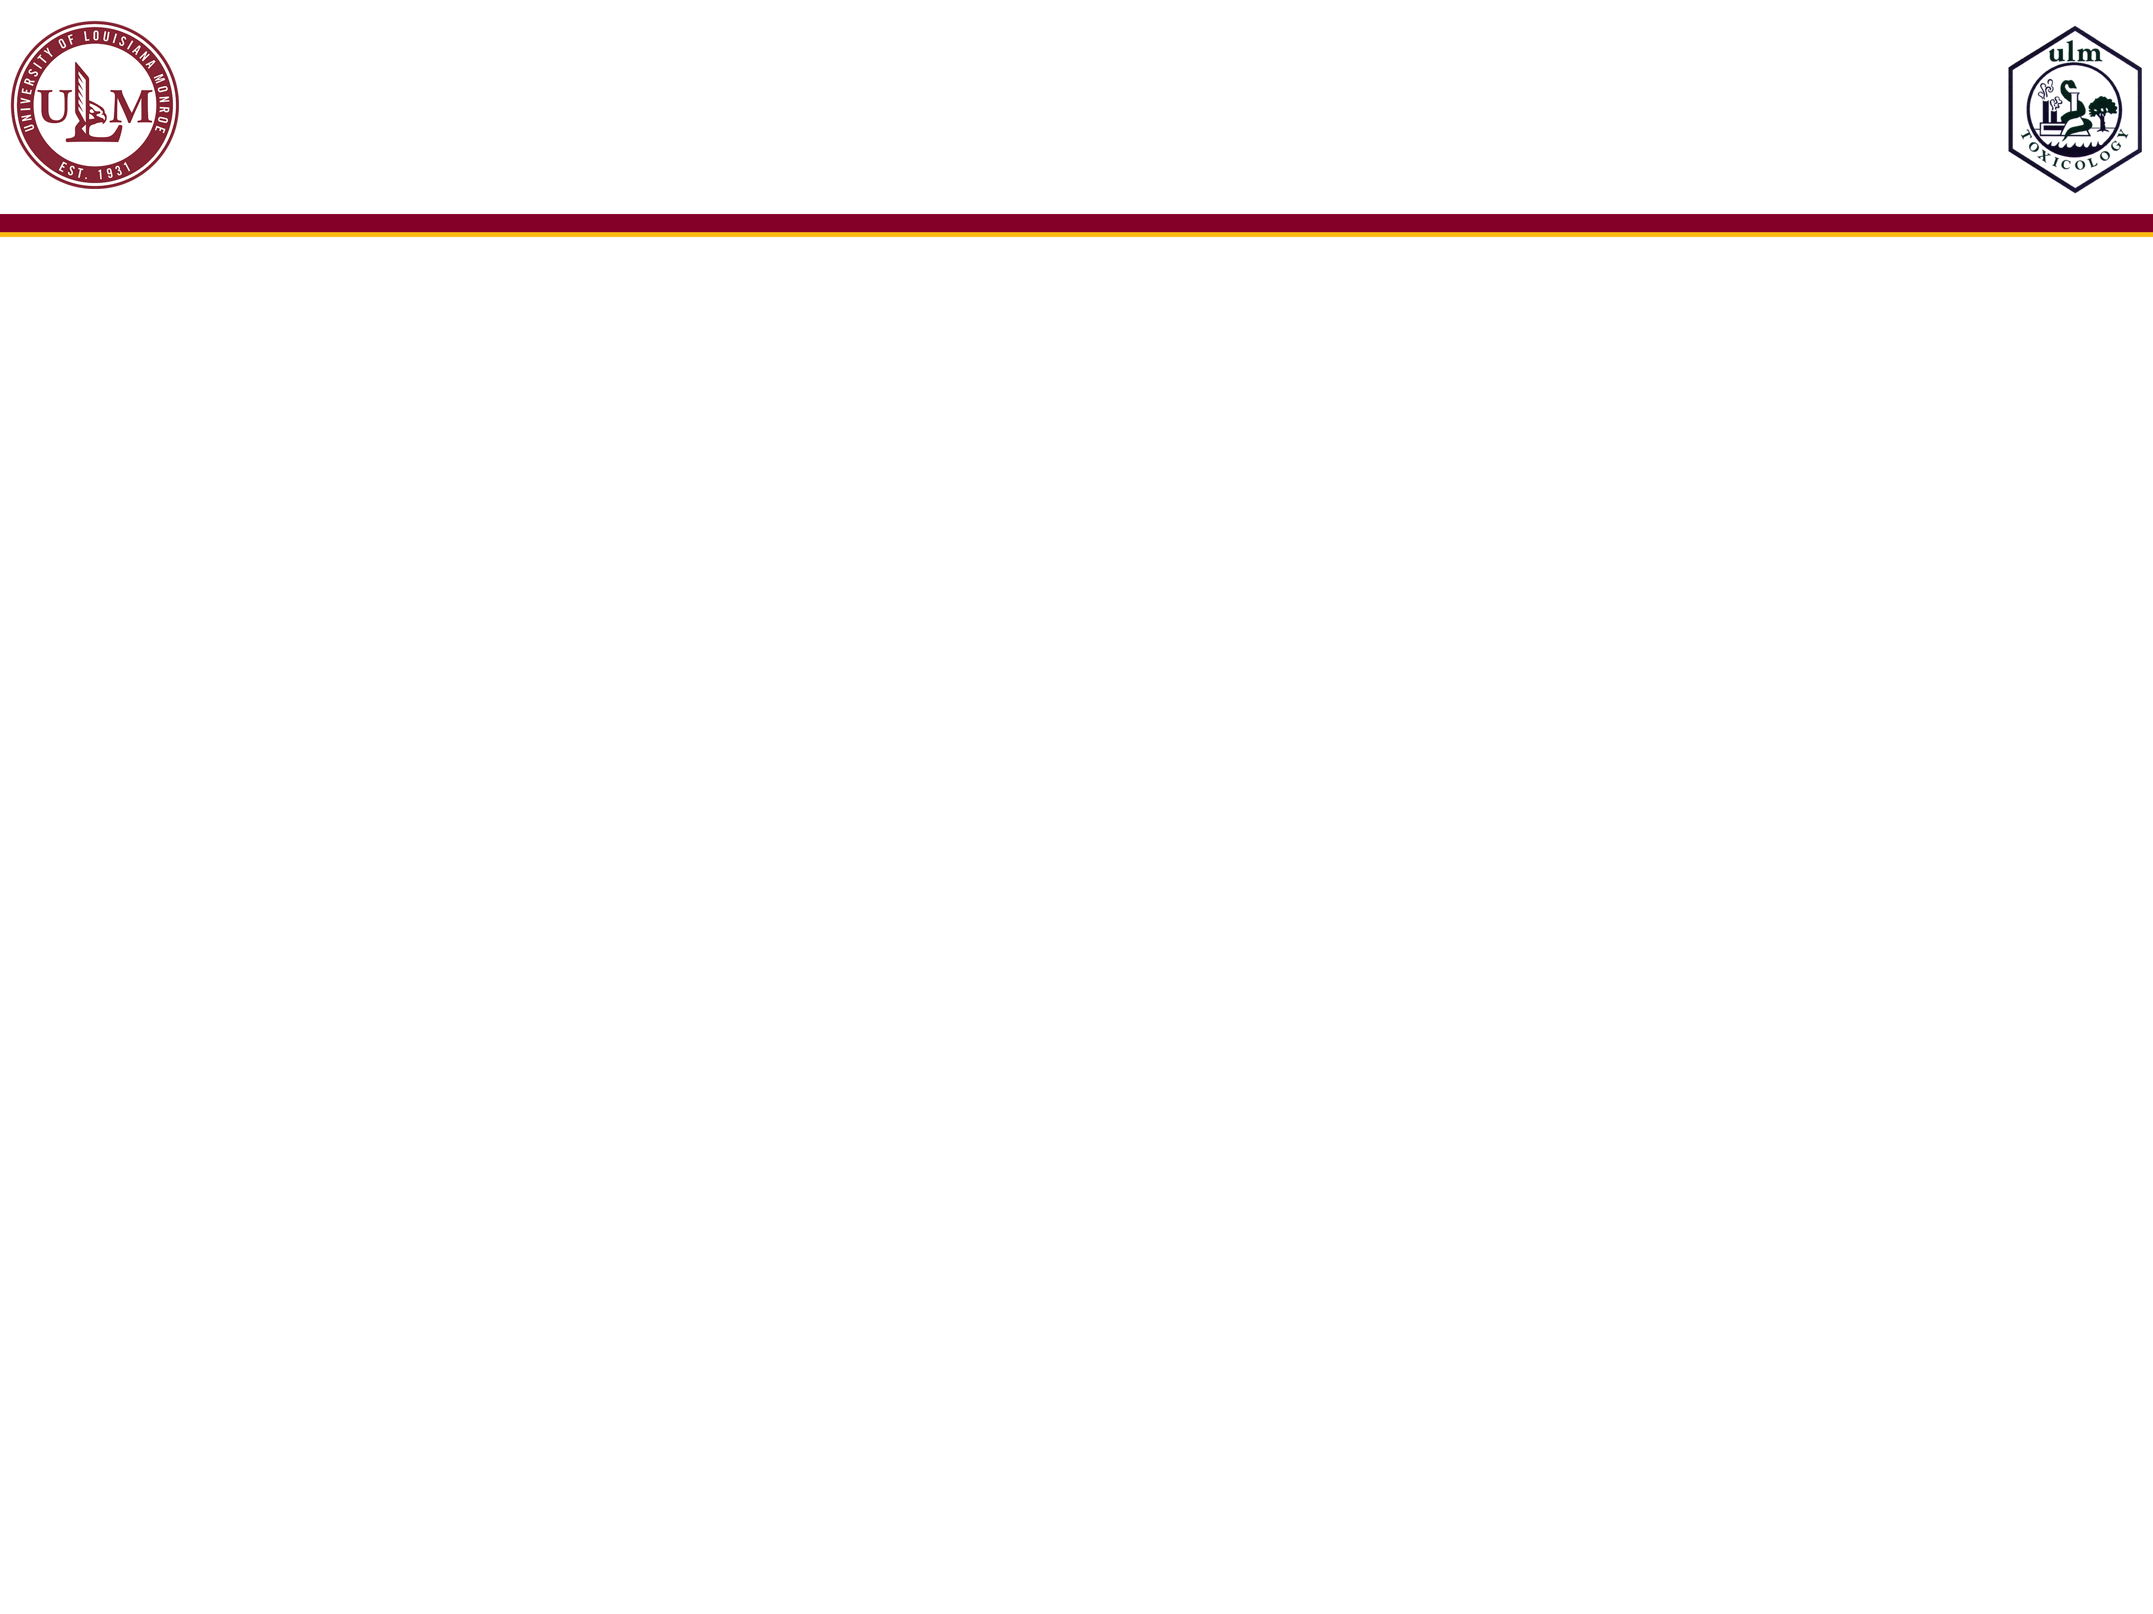
ULM Style Guide Colors
Primary Colors:
Warhawk (Maroon) - #840029; RGB – 134/0/41
Heritage Gold - #FDB913; RGB – 253/185/19
Secondary Colors:
Dark Grey - #646469; RGB – 100/101/105
Mid Dark Grey - #a9a8a9; RGB – 169/168/169
Mid Light Grey - #c8c9c7; RGB – 200/201/199
Light Grey - #dad8d6; RGB – 219/217/214
Gold – #bd955a; RGB – 190/149/91
Bright Gold - #efdbb2; RGB – 239/219/178
Typography:
Garamond (Mac/PC) – text
Times (Mac) - text
Times New Roman (PC) – text
Univers (Mac) – Headings
Arial (Mac/PC) – Headings
Helvetica (Mac) - Headings

