Slide 1

FEMA ASSUREd Safe Training
Sign-up Guide

Slide 2
About ASSUREd Safe
ASSUREd Safe is a non-profit, self-sustaining, fee-for-service federated ecosystem that provides standards, education, training, testing, and certification, of first responders' use of UAS for public safety and disaster operations.

Slide 3
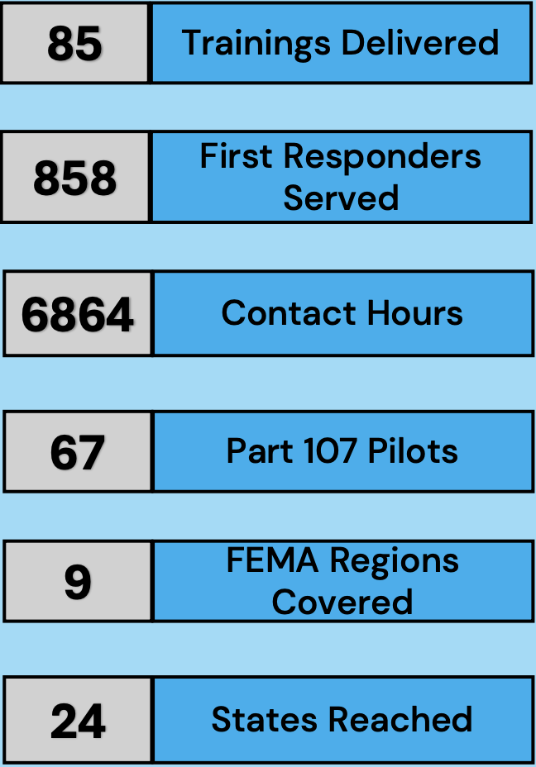
Impact Report
FEMA National Training and Education Division Partner
FIRST RESPONDER UAS TRAINING
2023-2024
The collaboration between ASSUREd Safe, FEMA and
NTED represents a powerful synergy at enhancing
emergency response capabilities through innovative
training solutions. This collaboration not only enhances
the quality of training available to emergency responders but also facilitates the adoption of UAS as a valuable tool in disaster response and recovery efforts nationwide.

Slide 4
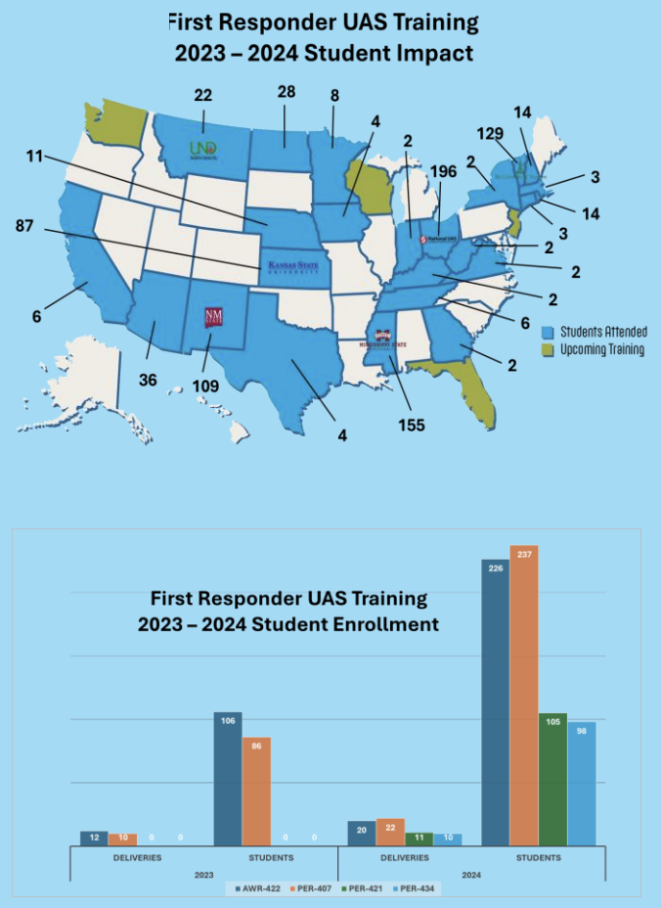
Harnessing UAS for Effective Emergency Management
“This training session will give emergency managers and first responders like me the ability to employ drone technology to address critical issues in emergency response,”

Slide 5
ULM Current Trainings
UAS Flight Operations for Emergency Response (AWR-422)*
is a 1-day, in-person course that will prepare first responders with technical resources, knowledge, and experience to deploy UAS for a variety of emergency response scenarios. Content will cover rules and regulations, mission planning, airspace coordination, platform and sensor selection, risk assessment and mitigation, flight operations, data collection, and metadata retention.
UAS Data Analytics for Emergency Response (PER-407)*
is a 1-day, in-person, instructor-led course on how to effectively organize, generate, analyze, and rapidly disseminate geospatial data from UAS data. Course content will cover how to transform UAS imagery, video, and other data into products that can be used to support decision-making, damage assessment, and other mission-critical tasks for emergency response.

Slide 6
ULM Course Information
Dates: 2-day Training
July 29, 2025: FEMA: AWR-422 Intro to UAS Flight Operations
July 30, 2025: FEMA: PER-407 Intro to UAS Data Analytics
Aug 5, 2025: FEMA: AWR-422 Intro to UAS Flight Operations
Aug 6, 2025: FEMA: PER-407 Intro to UAS Data Analytics

Slide 7

Instructors
Darrion Flunder-Jenkins
Director of Precision Ag & UAS Research Center / Assistant Professor of Aviation
Djenkins@ulm.edu
318-342-1168

Slide 8

Instructors
David King
Associate Professor of Aviation / Program Coordinator
Dking@ulm.edu
318-342-1784

Slide 9

Instructors
Lakeysha Bullock
Guess Instructor
lakeysha.bullock@ci.monroe.la.us

Slide 10
How to Sign-Up
*Note: This is a 2-day training held on July 29-30,2025 and Aug 5-6,2025.

Slide 11
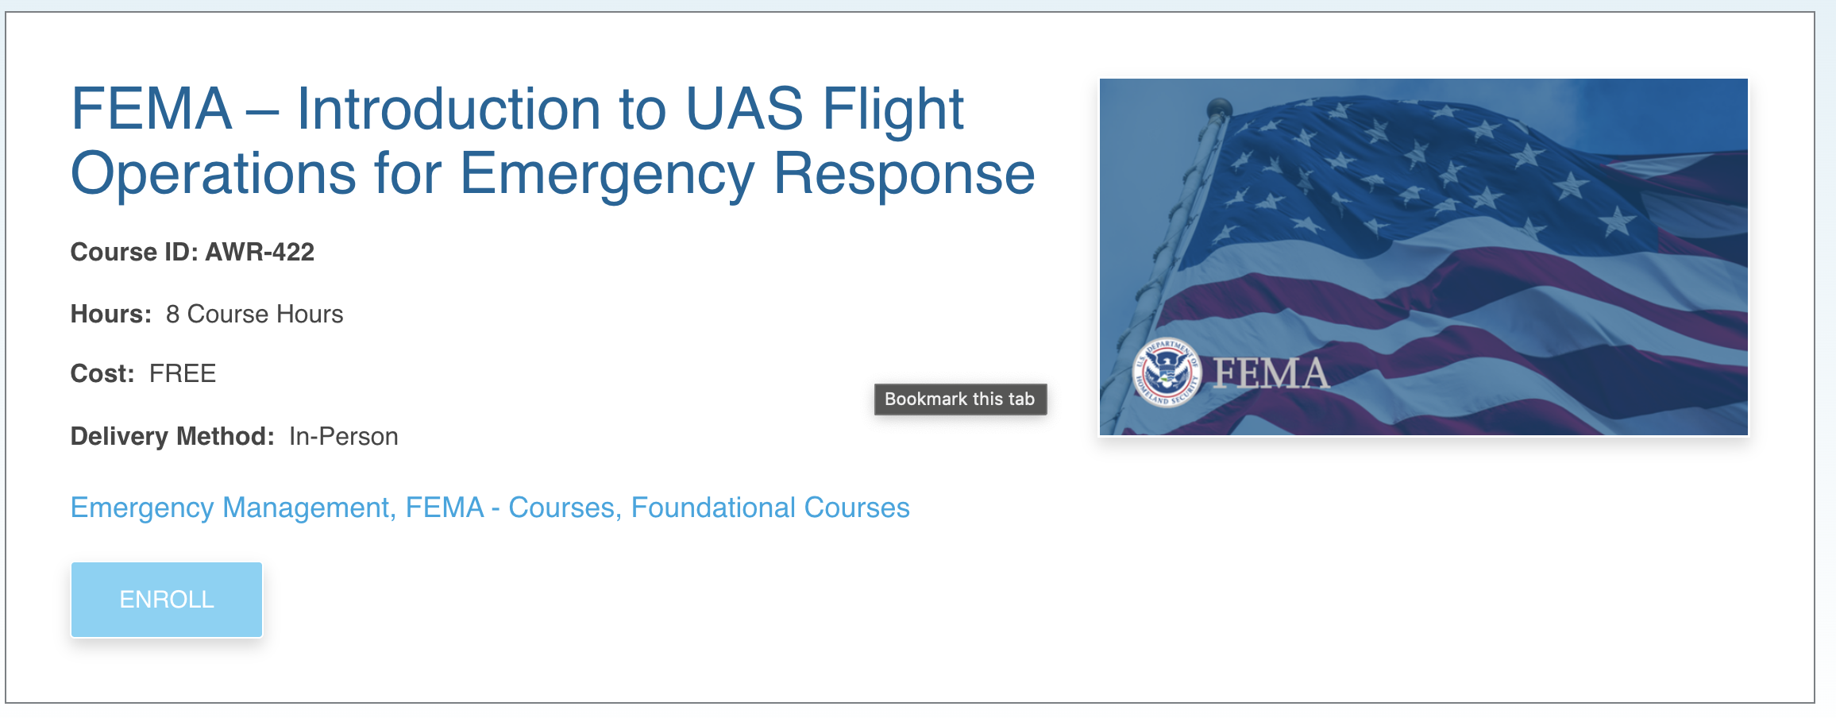
July 29-30, 2025
Click each date to sign up using the hyperlink.
July 29, 2025: FEMA: AWR-422 Intro to UAS Flight Operations
July 30, 2025: FEMA: PER-407 Intro to UAS Data Analytics

Slide 12
Aug 5-6, 2025
Click each date to sign up using the hyperlink.
Aug 5, 2025: FEMA: AWR-422 Intro to UAS Flight Operations
Aug 6, 2025: FEMA: PER-407 Intro to UAS Data Analytics

Slide 13
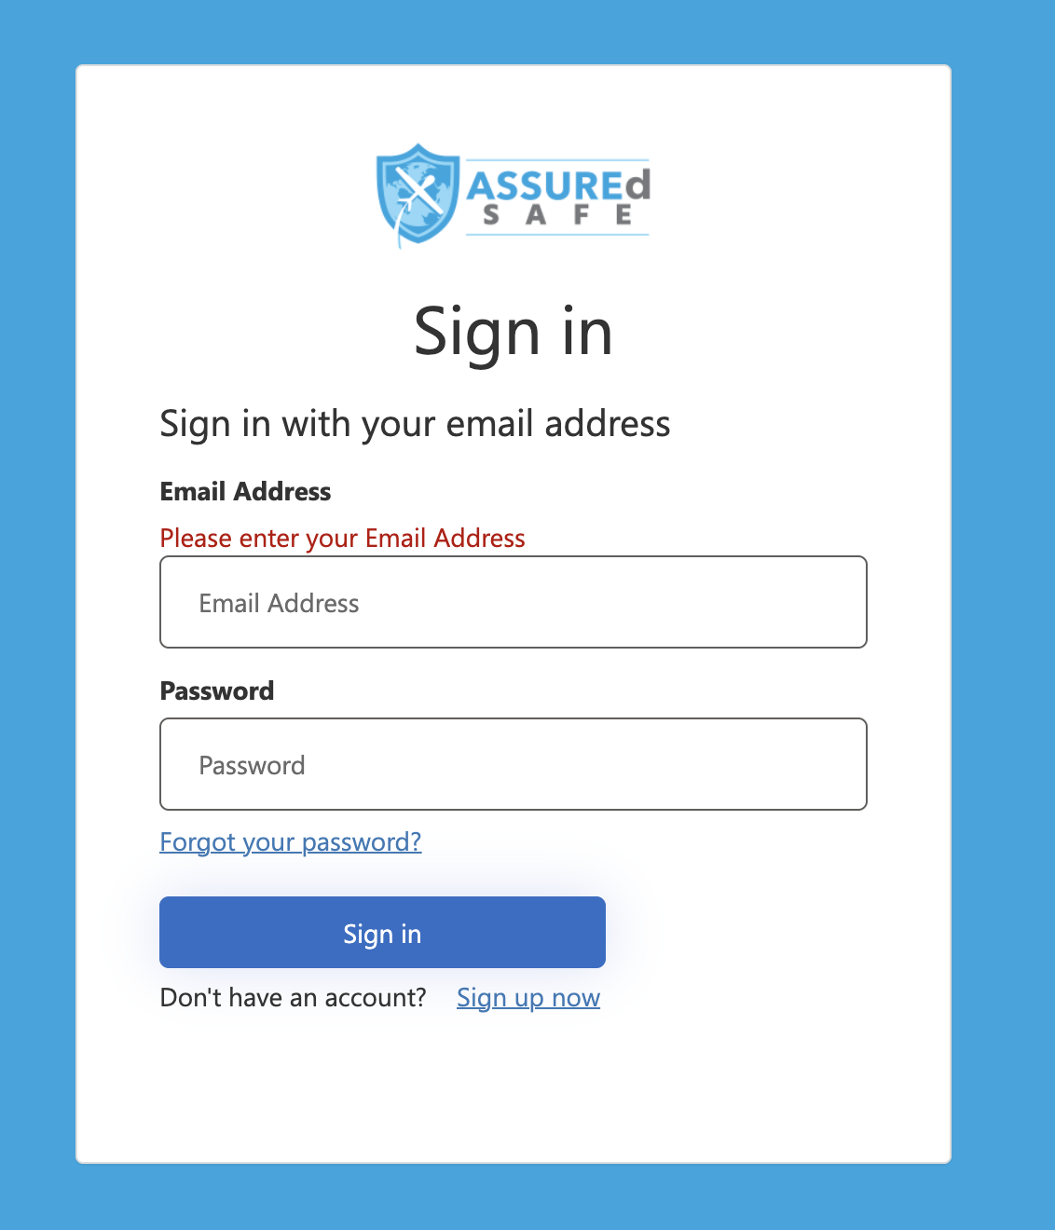
Click Enroll
Create a new account using Sign up now

Slide 14
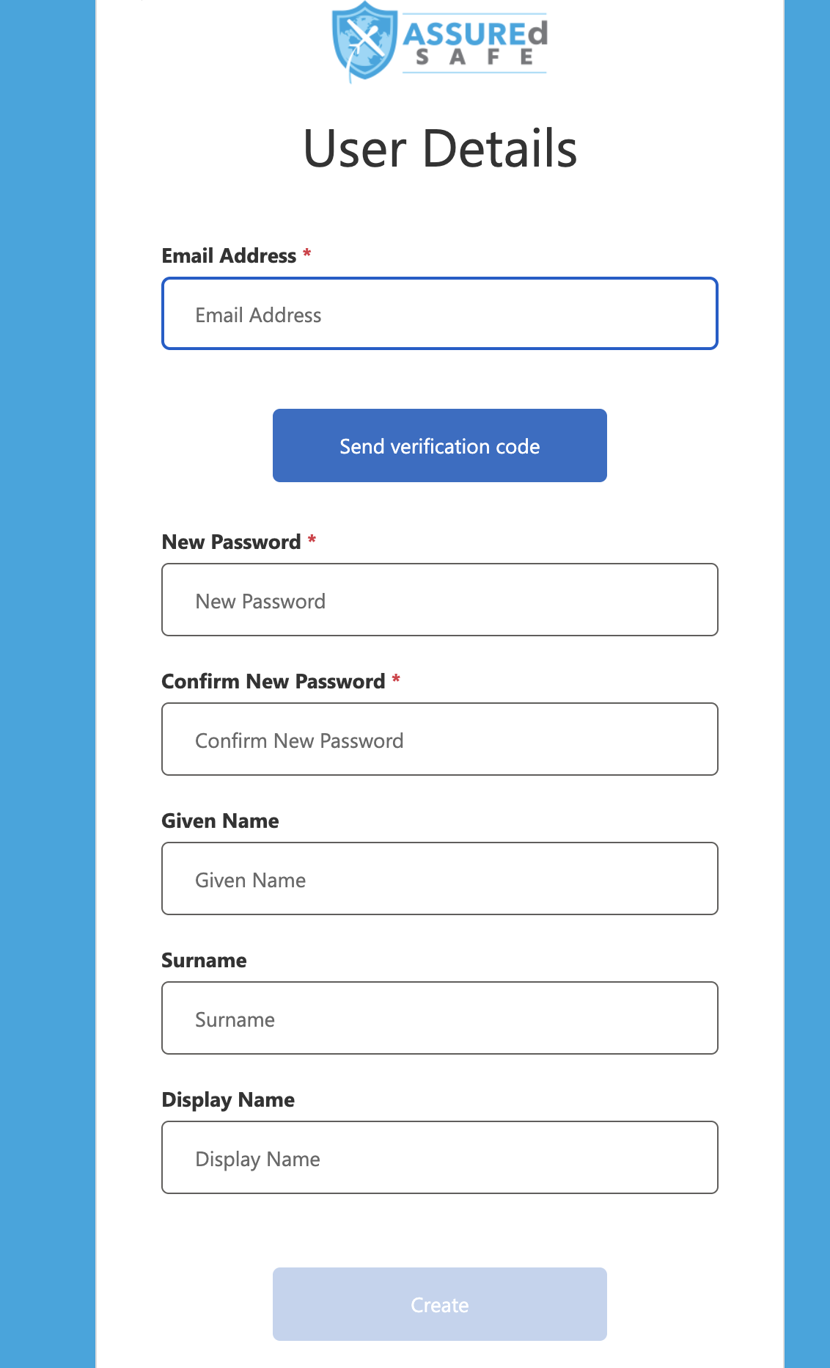
Sign up using your work email

Slide 15
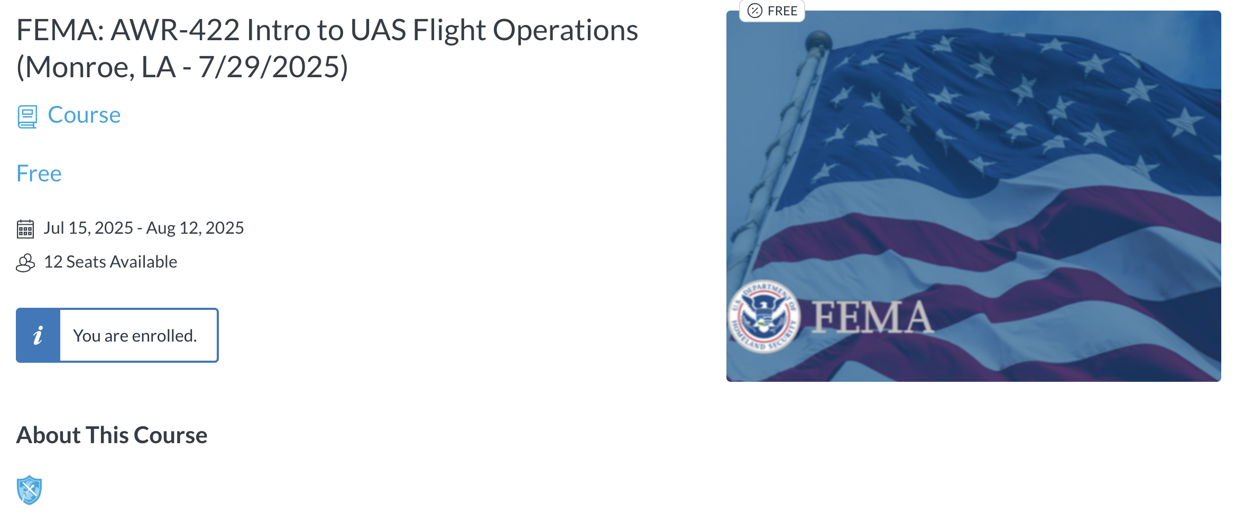
Once your account has been created, find your selected training dates for Monroe, LA and enroll.

Slide 16
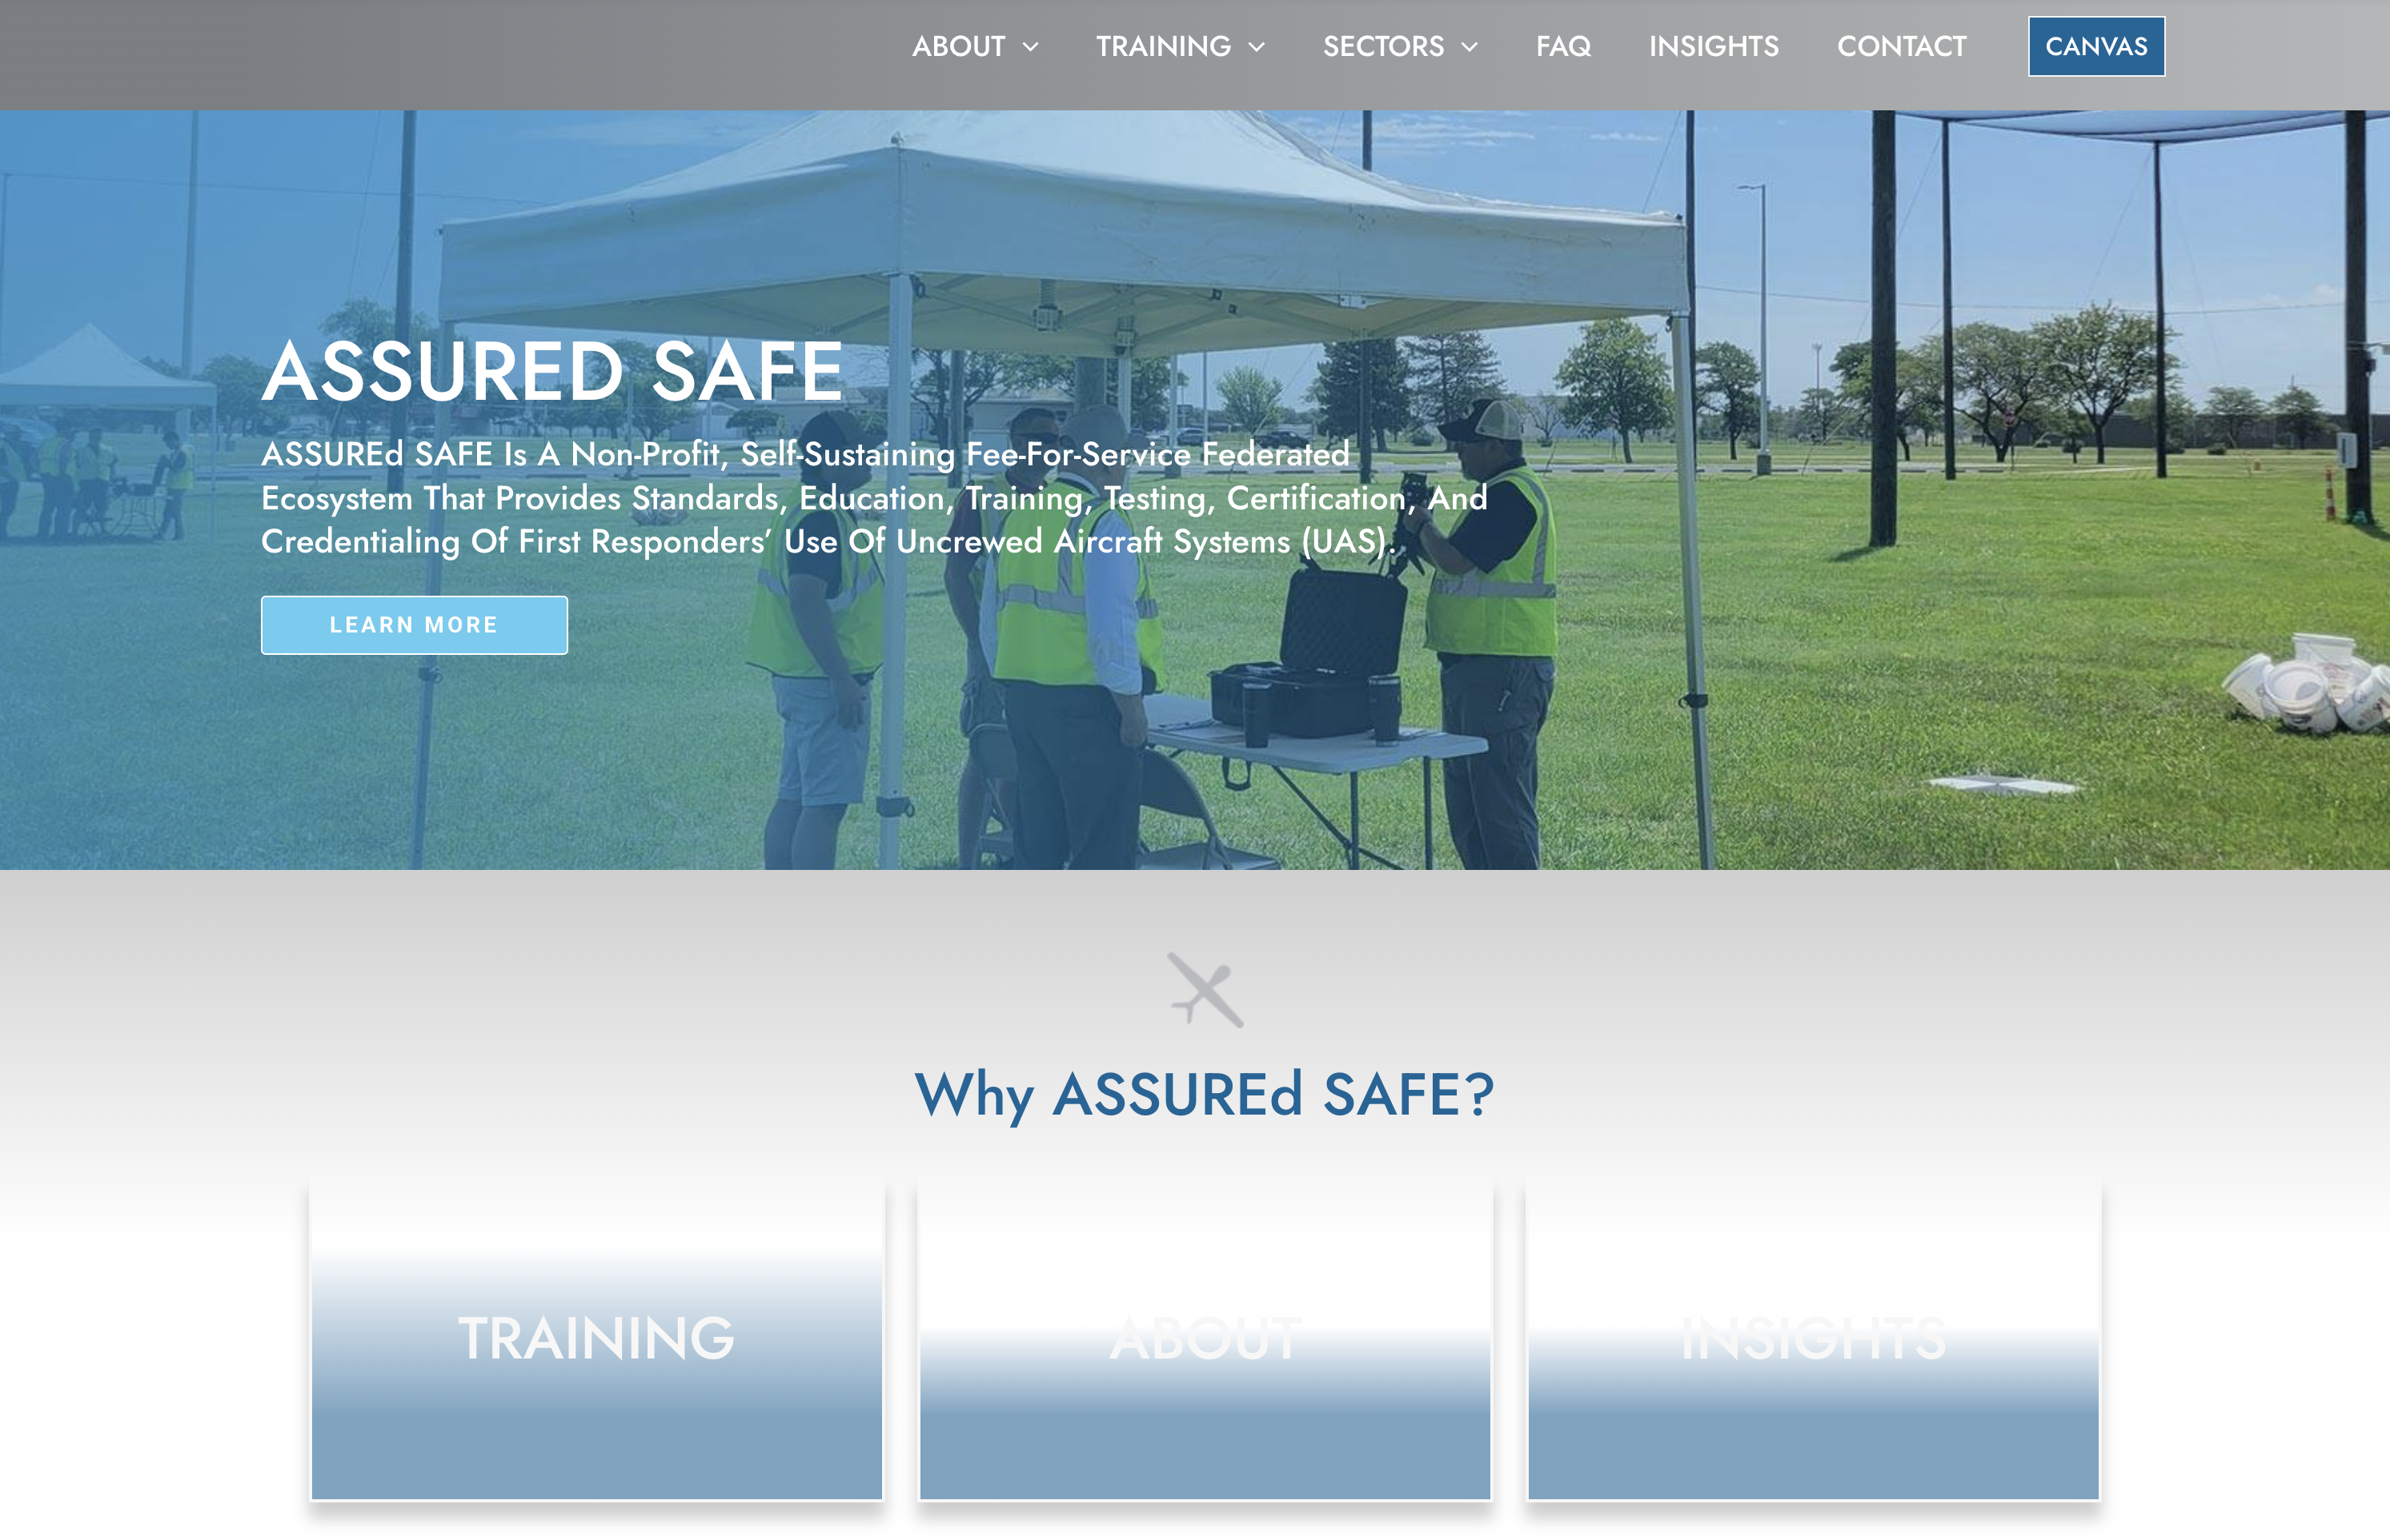
Once enrolled, look out for an email with further instructions
You can access the course platform at https://www.assuredsafe.org/
Click on CANVAS to sign into your account and course material.

Slide 17
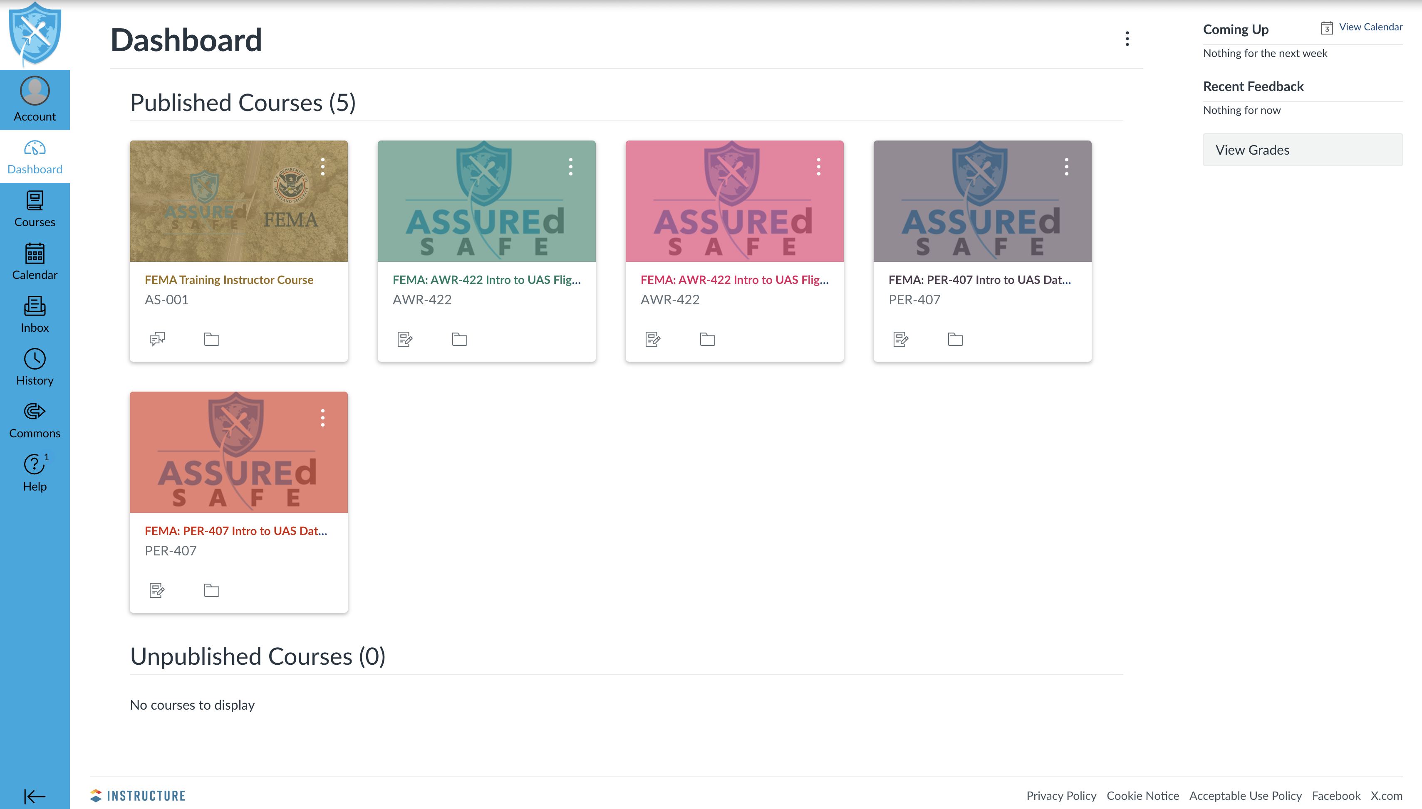
You can access your course via CANVAS at anytime

