Slide 1
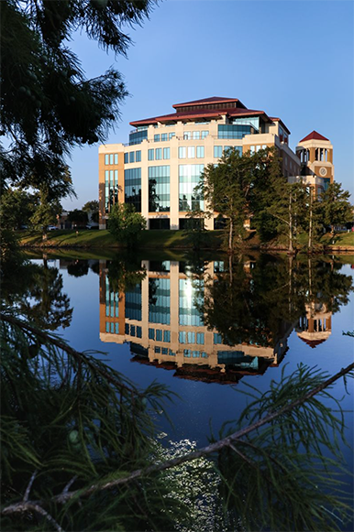
Tenure and Promotion 2026-2027
Office of Academic Affairs

Slide 2

Faculty value
Educational and Life Background
Professional Breadth/Depth of Experience
Teaching Ability and Effectiveness
Scholarly/Artistic Contributions
Service to Students, Campus, Community
Service to Discipline/Profession
Intellectual Curiosity and Influence
Drive, Talent, and Creativity
Enthusiasm and Attitude
Willingness to Adapt, Assist, & Collaborate
Professionalism and Collegiality
Connections with Students and Alumni
Ability to Care, Motivate, and Encourage
Many other quantifiable & qualitative factors

Slide 3
General expectations
Engage productively with other faculty, staff & students
Demonstrate a fair, diligent, and positive attitude toward the functioning of the school and the university
Understand and pursue quality standards as defined by the university and their academic unit’s criteria*
Participate in and welcome the guidance received from mentors, administrators, mid-tenure reviewers, annual evaluators, and colleagues
Demonstrate sustained and consistent performance and productivity
* School criteria are minimum requirements; their achievement does not imply automatic tenure.

Slide 4
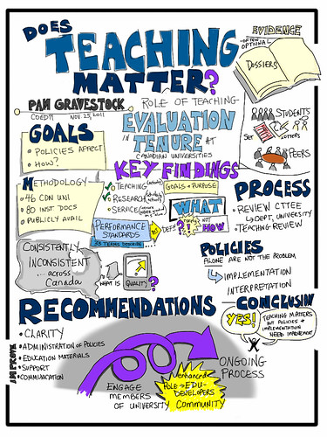
Some process specifics
Mentoring is Encouraged and Expected
Mid-tenure Review in 3rd Year
Criteria in force at time of hire used for tenure review (mostly)
Apply for tenure in 6th year
Early tenure (and/or promotion) only in exceptional cases
Promotion prior to or without tenure is not generally expected
Salary increase only for promotions, not granting of tenure
Promotion amounts for 2026-2027 are $3,500 for Associate Professor and $4,000 for Professor

Slide 5

The Portfolio
Make Your Case
Keep it straightforward and direct
Keep it organized and professional
Seek input and review from colleagues & school director
Ultimately, the portfolio is your responsibility
Changes after submission are generally not permitted
Additional material entered during process is limited and must be acknowledged by candidate
This Photo by Unknown Author is licensed under CC BY-SA

Slide 6
The Portfolio
Review prior portfolio submissions for more guidance
Build your case with a concise but powerful story
Limit portfolio to maximum of 40 pages
Include vitae, narrative, supporting documentation
Demonstrate quality in teaching, scholarly activity, service to the university and community, and overall contribution to the program, college and university
Use reasonable format (12-point font type, 1-inch margins)
Appendices are allowed – but keep them reasonable
Portfolio is submitted electronically to your Dean
Recommendation is available after each review
No specifics are provided as part of recommendation
This Photo by Unknown Author is licensed under CC BY-SA

Slide 7
Tenure vs Promotion
Tenure
Promotion
A status granted after a trial period to a teacher that gives protection from summary dismissal
Summary means quickly without delay or formality
The act or fact of being raised in position or rank
and
The act of furthering the growth or development of something
- While tenure provides some job security, it is not an unconditional guarantee of lifetime employment.
- Promotion and tenure are separate processes, though they often coincide.

Slide 8
Understanding Tenure
Definition
Status Types
An academic appointment that provides job security.
Tenure decisions are made after a probationary period & evaluation of performance.
Tenure is not an unconditional guarantee of lifetime employment.
Tenured: Faculty awarded an indeterminate appointment
Tenure-track: Faculty serving a probationary period while preparing to apply

Slide 9
Eligibility for Tenure
Eligible Faculty
Ineligible Positions
Full-time academic appointments at the rank of Assistant Professor or above
Administrators (except as members of academic disciplines)
Faculty paid from grants/contracts with limited appointments
Part-time/adjunct faculty members
Temporary faculty members
Faculty in instructor ranks
The Board of Supervisors has ultimate responsibility for hiring academic personnel and awarding or denying tenure.

Slide 10

Probationary Tenure Periods
Assistant Professor
Associate Professor & Professor
Six years of continuous service
During the fifth year, the Dean notifies faculty of eligibility to apply
Faculty submits application in the sixth year
Applicable when hired in at Associate or Full Professor rank
Minimum of two to four years of probationary service required - designated at hire
Professors may be granted tenure upon appointment at institution’s discretion
Years of service are counted beginning with the individual's first full-time fall semester
Credit toward tenure must be negotiated during hiring. Terms must be captured in writing & approved by the Dean and Provost.

Slide 11
Special Circumstances
Credit may be given for prior service at other institutions with mutual consent.
Employment beginning before January 1 counts that entire academic year toward probation.
Employment beginning on/after January 1 starts probationary period the following fall.
Tenure clock suspension available during leaves, disasters, pandemics, etc. Policies and procedures must be followed.
In exceptional cases, extraordinarily meritorious faculty may receive tenure before completing the probationary period but this situation is very rare.

Slide 12
Tenure Clock Examples
Fall 2026 Start Date
Spring 2027 Start Date - after Jan 1, 2027
3rd Year Mid-tenure Review in 2028-2029
Apply for Tenure in Fall 2031
Tenure Review Process in Spring 2032
3rd Year Mid-tenure Review in 2029-2030
Apply for Tenure in Fall 2032
Tenure Review Process in Spring 2033
- While tenure provides job security, it is not an unconditional guarantee of lifetime employment.
- Promotion and tenure are separate processes, though they often coincide.

Slide 13




Tenure Process & Support
Faculty Mentor Assignment
Third-Year Review
School director appoints tenured faculty mentor(s) during first semester
Formal review to assist with progress toward tenure
Application Preparation
Multi-Level Review
Faculty prepares portfolio with documentation
School, college, and university evaluation
Those individuals who have a separate recommendation in the tenure process cannot serve as a faculty mentor.

Slide 14
Detailed Promotion and Tenure Timetable
This timeline outlines key dates and actions for faculty members applying for promotion and/or tenure during the 2026-27 academic year.
Should the due date fall on a weekend, the due date shall be observed on the next business day.
Fall 2026 (Sixth Year)
1
Faculty member meets with the School Director to discuss promotion and the application process.
2
September 15, 2026
Faculty completes and has School Director sign the "Application for Promotion and/or Tenure" for portfolio inclusion.
September 30, 2026
3
School and Library Promotion & Tenure Committees are formed.
4
January 15, 2027
The College/Library faculty submits their portfolio to the Dean.
February 15, 2027
5
The School/Library Promotion & Tenure Committee submits its recommendation to the School/Library Director.
6
March 1, 2027
The School Director submits a recommendation to the Dean.
March 15, 2027
7
The College Promotion & Tenure Committee submits its recommendations to the Dean.
8
April 1, 2027
Dean/Library Director submits college recommendation to the Provost and Vice President for Academic Affairs.
May 1, 2027
9
The Provost and VPAA submits a recommendation to the President.
10
August 2027
The President submits a recommendation to the ULS Board of Supervisors.

Slide 15

Promotion Overview
Definition
Promotion refers to elevation in academic rank through various levels of an individual's position.
Seeking promotion is a significant milestone in the ongoing process of faculty development.

Slide 16
Promotion Overview
Evaluation Basis & Expectations
Faculty achievements and contributions since the last promotion (or hire) are used to evaluate candidates.
A sufficient period of time, typically consistent with the tenure probationary period since the last promotion (or hire), has passed.
Annual evaluations should be carefully considered in assessment.
Program criteria are minimum requirements; their achievement does not imply automatic promotion.
Promotions are based on consistent performance of work over time and at a high quality level.

Slide 17
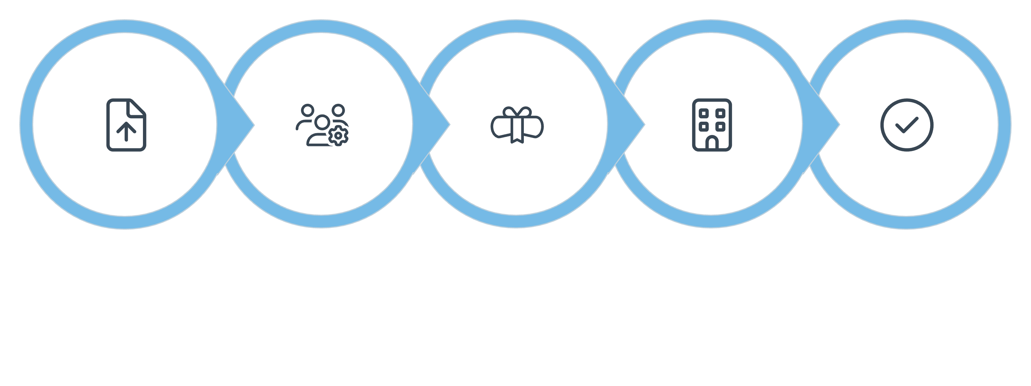





Promotion Process
Submit Application
School Review
College Review
Administrator Reviews
Final Decision
The procedure for evaluating a faculty member's application for promotion will be the one in force at the time of application, though the criteria will remain those in force at the time of applicant's hire or most recent promotion.

Slide 18
Appeals Process
Appeal Process
Appeal Basis
Appeal Reviewers
Faculty may appeal if they believe the promotion or tenure process has been violated. Recommendations themselves cannot be appealed.
The appeal process can be found in the Faculty Handbook.
Generally, the Faculty Senate forms an ad-hoc Committee to handle the appeal. There is an alternate option to appeal to the Provost and VPAA.

